Slide 1
Parallel and Distributed Computing Overview (CS 3006)
Muhammad Aadil Ur Rehman
Department of Computer Science,
National University of Computer & Emerging Sciences, Islamabad Campus
Credits: Dr. Muhammad Aleem

Slide 2
Distributed Systems - Definition
A distributed system is a software system in which components located on networked computers communicate and coordinate their actions by passing messages (to achieve a common goal)
How to Program Distributed Computers?
- Message Passing based Programming Model

Slide 3
MPI (Message Passing Interface)?
Standardized message passing library specification
for parallel computers clusters
not a specific product, compiler specification etc.
many implementations, MPICH, LAM, OpenMPI …
Portable, with Fortran and C/C++ interfaces
Real parallel programming

Slide 4
A Brief History - MPI
Writing parallel applications is fun!!
Initially, it was a difficult:
No single standard
Various implementations (with different features)
Solution: a MPI standard was defined
Supporting same features and semantics across implementations
By 1994, a complete interface and standard was defined (MPI-1)
Result: Portable Parallel Programs
Notes:
http://mpitutorial.com/tutorials/mpi-introduction/
an application passes messages among processes in order to perform a task
For instance, a master process might assign work to slave processes by passing them a message that describes the work.

Slide 5
The Message-Passing Model
Two major requirements:
Creating separate processes for execution on different computers
Method of sending and receiving messages
Machine
Machine
Process
Machine
Process
Communication
System
(MPI)
Process
Process
Process
Data exchange
Process
Machine
Process
Process

Slide 6
The Message-Passing Model
A process is (traditionally) a program counter and address space
Processes may have multiple threads
program counters and associated stacks
sharing a single address space
MPI is for communication among processes
separate address spaces
Inter-process communication consists of:
Synchronization
Data movement from one process’s address space to anothers

Slide 7
Types of Parallel Computing Models
Data Parallel
Same instructions are carried out simultaneously on multiple data items (e.g., SIMD)
Task Parallel
Different instructions on different data (e.g., MIMD)
SPMD (Single Program, Multiple Data)
Not synchronized at individual instruction level (e.g., MIMD style execution)
→ MPI is for MIMD/SPMD type of parallelism

Slide 8
The Message-Passing Programming Paradigm
Sequential Programming Paradigm:
data
memory
A processor may run many processes
program
Processor/Process
Message-Passing Programming Paradigm
data
data
data
data
distributed
memory
program
program
program
program
parallel
processors
communication network

Slide 9
The Message-Passing Programming Paradigm
A process is a program performing a task on a processor
Each processor/process runs a instance/copy of the same program:
the variables of each sub-program have:
the same name but different locations (distributed memory) and different data
i.e., all variables are local to a process
communicate via message passing
data
data
data
data
distributed
memory
program
program
program
program
parallel
processors
communication network

Slide 10
Data and Work Distribution
To communicate together MPI-processes need identifiers: rank = identifying number
Processes are identified using rank
myrank=0
data
myrank=1
data
myrank=2
data
myrank= (size-1)
data
program
program
program
program
communication network

Slide 11
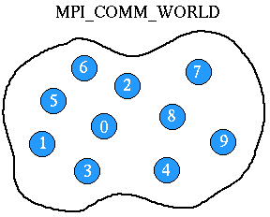
MPI Fundamentals
A communicator defines a group of processes that have the ability to communicate with one another
In a group, each processes is assigned a unique rank
Use rank to explicitly communicate with one another

Slide 12
Communicators
When you start an MPI program, there is one predefined communicator MPI_COMM_WORLD
Notes:
Communicators can be created “by hand” or using tools provided by MPI (not discussed in this tutorial)

Slide 13
Communicators
When you start an MPI program, there is one predefined communicator MPI_COMM_WORLD
Notes:
Communicators can be created “by hand” or using tools provided by MPI (not discussed in this tutorial)

Slide 14
Communicators
Communicators do not need to contain all processes in the system
When you start an MPI program, there is one predefined communicator MPI_COMM_WORLD
0
1
2
3
Every process in a communicator has an ID called as “rank”
4
5
6
7
Notes:
Communicators can be created “by hand” or using tools provided by MPI (not discussed in this tutorial)

Slide 15
Communicators
Communicators do not need to contain all processes in the system
When you start an MPI program, there is one predefined communicator MPI_COMM_WORLD
0
1
0
1
2
2
3
3
Every process in a communicator has an ID called as “rank”
4
5
4
6
5
7
6
7
The same process might have different ranks in different communicators
Notes:
Communicators can be created “by hand” or using tools provided by MPI (not discussed in this tutorial)

Slide 16
Communicators
Communicators do not need to contain all processes in the system
When you start an MPI program, there is one predefined communicator MPI_COMM_WORLD
0
1
0
1
2
2
3
3
Every process in a communicator has an ID called as “rank”
4
5
4
6
5
7
6
7
The same process might have different ranks in different communicators
Simple programs typically only use the predefined communicator MPI_COMM_WORLD
Notes:
Communicators can be created “by hand” or using tools provided by MPI (not discussed in this tutorial)

Slide 17
Communicator MPI_COMM_WORLD
All processes of an MPI program are members of the default communicator MPI_COMM_WORLD
MPI_COMM_WORLD is predefined
Additional communicators can also be defined
Each process has its own rank in a communicator:
starting with 0
Ending with (size-1)
MPI_COMM_WORLD
1
0
2
5
4
3
6

Slide 18
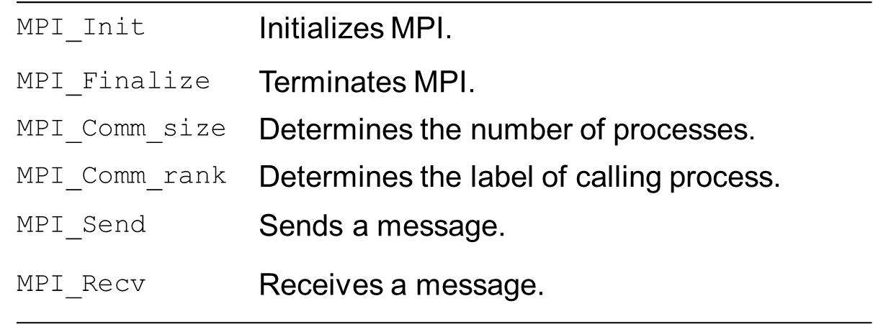
How big is the MPI library?
Huge (125 Functions) !!
Good news – you can write useful MPI programs only using 6 basic functions

Slide 19
MPI – Start & Termination
int MPI_Init(int *argc, char ***argv)
initialization: must call this prior to other MPI routines (by main thread)
initializes MPI environment
int MPI_Finalize( )
Must call at the end of the computation (by the same main thread)
performs various clean-up tasks to terminate MPI environment
Return codes (for both MPI_Init & MPI_Finalize)
MPI_SUCCESS
MPI_ERROR
Notes:
This routine must be called by one thread only. That thread is called the main thread and must be the thread that calls MPI_Finalize.

Slide 20
Communicators
Communicator: MPI_Comm
Group of processes that could communicate with one another
Communication domains could overlap
A process may be part of multiple communicators
MPI_COMM_WORLD: root communicator (all the processes)

Slide 21
Communicators
int MPI_Comm_size(MPI_Comm comm, int *size)
Determine the number of processes (in a particular communicator)
int MPI_Comm_rank(MPI_Comm comm, int *rank)
Index of the calling process (in a particular communicator)
0 ≤ rank < communicator size

Slide 22
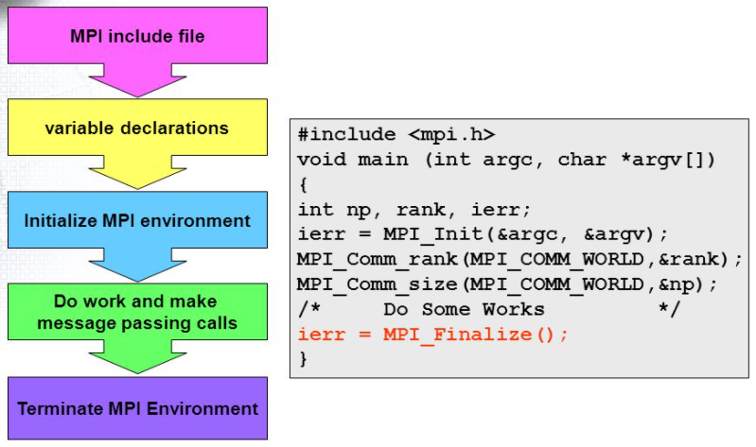
MPI Program – A Generic Structure
Credits: http://foxtrot.ncsa.uiuc.edu:8900/public/MPI / MPI Program Structure

Slide 23
A minimal MPI Program
Demo: hello.c
#include <mpi.h>
#include <stdio.h>
int main(int argc, char *argv[])
{
MPI_Init(&argc, &argv);
printf(“Hello PDC Class!\n”);
MPI_Finalize();
return 0;
}

Slide 24
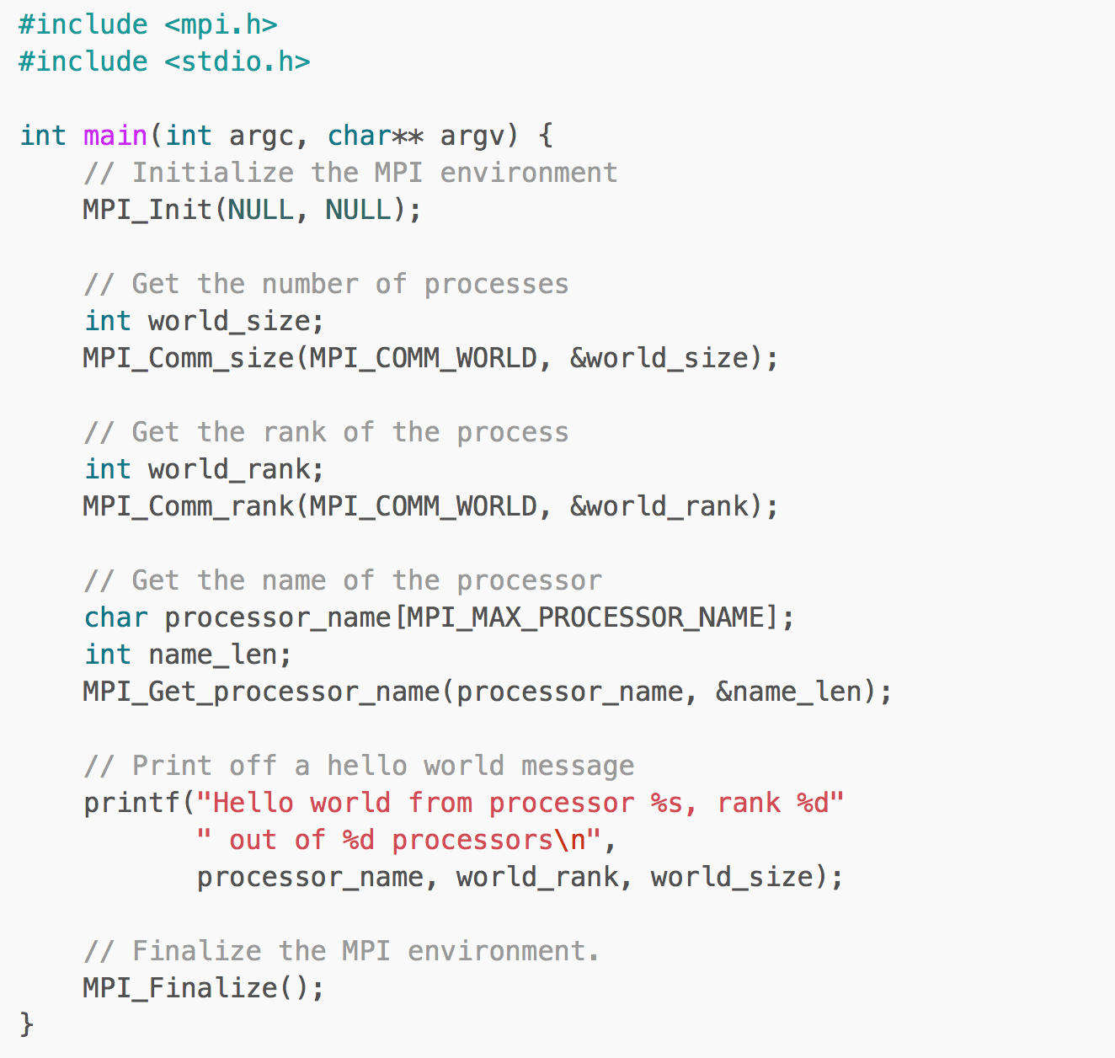
Demo: processorName.c
Notes:
Processor name is useful for the programs where we utilize migration aspect (to see where the process is currently executing)

Slide 25
MPI header file
Demo: processorName.c
Notes:
Processor name is useful for the programs where we utilize migration aspect (to see where the process is currently executing)

Slide 26
MPI environment initialization, all of MPI's global and internal variables are constructed. For example, a communicator is formed around all of the processes that were spawned, and unique ranks are assigned to each process.
Demo: processorName.c
Notes:
Processor name is useful for the programs where we utilize migration aspect (to see where the process is currently executing)

Slide 27
MPI_Comm_size returns the size of a communicator. Here, MPI_COMM_WORLD encloses all of the processes, so this call should return the amount of processes that were requested for the job.
Demo: processorName.c
Notes:
Processor name is useful for the programs where we utilize migration aspect (to see where the process is currently executing)

Slide 28
MPI_Comm_rank returns the rank of a process in a communicator. Ranks are incremental starting from zero and are primarily used for identification purposes during send/receive.
Demo: processorName.c
Notes:
Processor name is useful for the programs where we utilize migration aspect (to see where the process is currently executing)

Slide 29
MPI_Get_processor_name obtains the actual name of the processor on which the process is executing.
Demo: processorName.c
Notes:
Processor name is useful for the programs where we utilize migration aspect (to see where the process is currently executing)

Slide 30
Demo: processorName.c
clean up the MPI environnent
Notes:
Processor name is useful for the programs where we utilize migration aspect (to see where the process is currently executing)

Slide 31
Demo: processorName.c
Notes:
Processor name is useful for the programs where we utilize migration aspect (to see where the process is currently executing)

Slide 32
Compiling MPICH Program
Regular C applications:
gcc hello_world.c –o hello_world
MPI based C applications
mpicc mpi_hello_world.c –o mpi_hello_world

Slide 33
Running MPICH Program
Regular C applications
./hello_world
MPI based C applications (running with 16 processes)
mpiexec –n 16 ./mpi_hello_world

Slide 34
Running MPICH Program on a Cluster
On Clusters, you will have to set up a host file (named machinefile in our earlier demo)
The host file contains names of all of the nodes on which your MPI job will execute
Example (machinefile contents):
slave1:4 # this will spawn 4 processes on slave1
master:2 # this will spawn 2 processes on master
and executed it using
mpiexec -n 8 -f machinefile ./mpi_hello

Slide 35
Running MPICH Program on a Cluster
As shown, the MPI program was launched across all of the hosts in machinefile
Each process was assigned a unique rank, which was printed off along with the process name.
The output of the processes is in an arbitrary order since there is no synchronization involved before printing

Slide 36
Congratulations !!
You now have a basic understanding about how MPI works
Even better, you already have a cluster and you can write parallel programs !!

Slide 37
Point-to-Point Communication

Slide 38
Data Messages
A message contains a number of elements of some particular datatype
Example: message with 5 integers
2345
654
96574
-12
7676

Slide 39
Point-to-Point Communication
Communication between two processes
Source process sends message to destination process
Communication takes place within a communicator, e.g., MPI_COMM_WORLD
Processes are identified by their ranks in the communicator
0
2
1
message
5
4
3
destination
source
6

Slide 40
Point to Point Communication
Communication is done using send and receive among processes:
To send a message, sender provides the rank of the process and a unique tag to identify the message
The receiver can then receive a message with a given tag (or it may not even care about the tag), and then handle the data accordingly
Two basic (and simple) functions, MPI_Send and MPI_Recv

Slide 41
MPI_Send & MPI_Recv
User Mode
Kernel Mode
sendbuf
Sending process waits until all data are transferred to the system buffer
sysbuf
MPI_Send(sendbuf,1)
Copying data from
sendbuf to sysbuf
(blocked)
Now sendbuf can be reused
Send data from
sysbuf to dest
Data
User Mode
Kernel Mode
Receiving process waits until all data are transferred from the system buffer to the receive buffer
MPI_recv(recvbuf,0)
Receive data from
src to sysbuf
(blocked)
Copying data from
sysbuf to recvbuf
Now recvbuf contains valid data
sysbuf
recvbuf

Slide 42
Data Communication in MPI
Communication requires the following information:
Sender has to know:
Whom to send the data to (receiver’s process rank)
What kind of data to send (100 integers or 200 characters,..)
A user-defined “tag” (distinguish different messages)
Receiver “might” have to know:
Who is sending Or wildcard: MPI_ANY_SOURCE (meaning anyone can send)
kind of data is being received (may be partial info, e.g., upper bound)
Message “tag” Or wildcard: MPI_ANY_TAG (any message)
Notes:
Partial information: may be 1000 integers, etc. This is an upper bound and does not reflects that the same number of integers should be received in every message.

Slide 43
MPI_Send
MPI_Send(void* data, int count, MPI_Datatype type, int dest, int tag, MPI_Comm comm)
data: pointer to data
count: number of elements to send
type: data type of data
dest: destination process (rank)
tag: identifying tag
comm: communicator
Blocking operation
When MPI_Send returns the message is sent and the data buffer can be reused (the message may not have been received by the target process yet)

Slide 44
MPI_Recv
MPI_Recv(void* data,int count,MPI_Datatype type, int source,int tag,MPI_Comm comm,MPI_Status* status)
data: pointer to data
count: number of elements to be received (upper bound)
type: data type
source: source process of the message
tag: identifying tag
comm: communicator
status: i.e., sender, tag, and message size
When MPI_Recv returns the message has been received
Waits until a matching (on source, tag, comm) message is received
Notes:
Source, tag, and communicator must match a send for MPI_Recv to return.

Slide 45
Elementary MPI datatypes
Similar to C datatypes, portable MPI datatypes
int → MPI_INT
double → MPI_DOUBLE
char → MPI_CHAR
Complex datatypes also possible:
E.g., a structure datatype that comprises of other datatypes → a char, an int and a double
Notes:
Introduction to MPI, Argonne (06/06/2014)

Slide 46
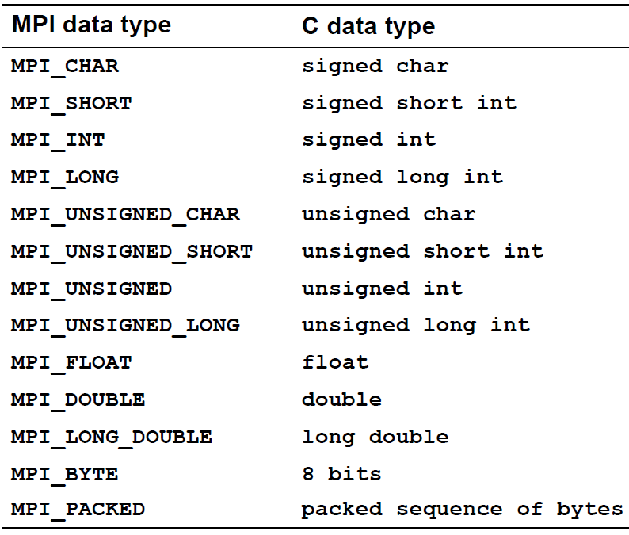
Elementary MPI datatypes
Notes:
Introduction to MPI, Argonne (06/06/2014)
Bytes Taken: https://www.mcs.anl.gov/research/projects/mpi/mpi-standard/mpi-report-2.0/node200.htm

Slide 47
Simple Communication in MPI
#include <mpi.h>
#include <stdio.h>
int main(int argc, char **argv)
{
int rank;
MPI_Init(&argc, &argv);
MPI_Comm_rank(MPI_COMM_WORLD, &rank);
if (rank == 0){
char sdata[] = "Hello PDC";
MPI_Send(sdata, 9, MPI_CHAR, 1, 0, MPI_COMM_WORLD);
}
else if (rank == 1) {
char rdata[]="";
MPI_Recv(rdata,9,MPI_CHAR,0,0,MPI_COMM_WORLD,MPI_STATUS_IGNORE);
printf("\nI am a slave,received %s message from master\n", rdata);
}
MPI_Finalize();
return 0;
}
Demo: P2P.c
Process rank or id
Message tag
Notes:
Size of data is +1 (i.e., 11 chars and 1 for NULL)

Slide 48
The MPI_Status structure
Information is returned from MPI_RECV in status
For the messages received using wildcards (MPI_ANY_TAG, MPI_ANY_SOURCE)
Receiver can check actual “Source” and “Tag” of the message
MPI_STATUS_IGNORE can be used if we don’t need any additional information

Slide 49
The MPI_Status structure
int MPI_Get_count(MPI_Status* status,
MPI_Datatype type,
int* count)
In MPI_Get_count, the user passes the MPI_Status structure, the datatype of the message, and count is returned
count variable is the total number of elements that were received

Slide 50
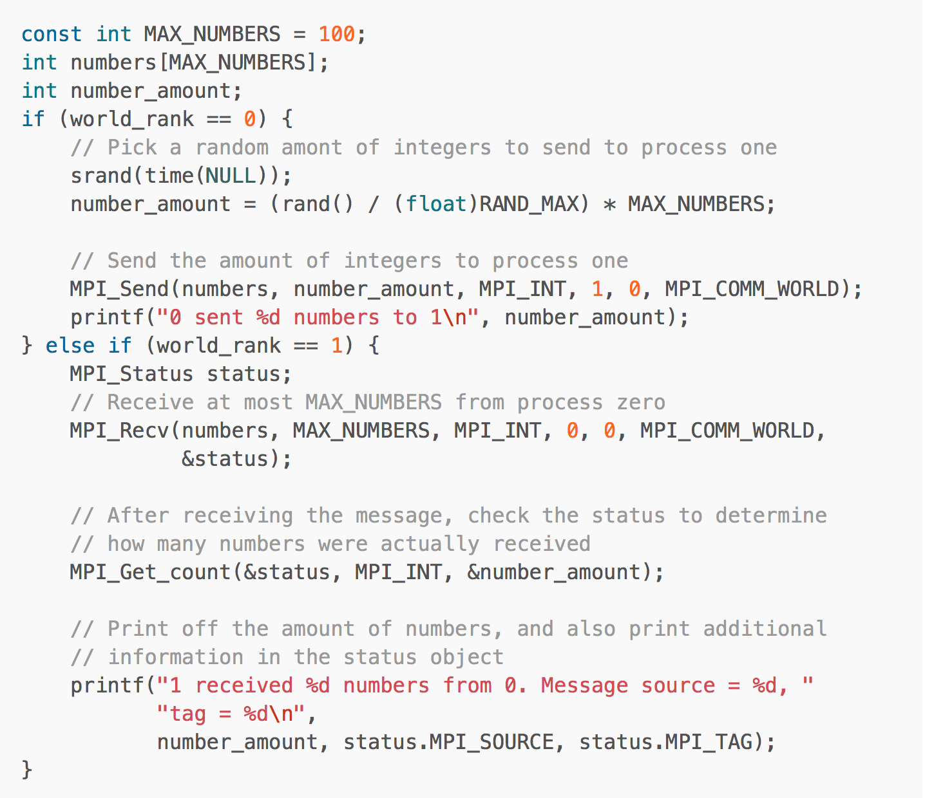
An example
Demo: P2PStatus.c

Slide 51
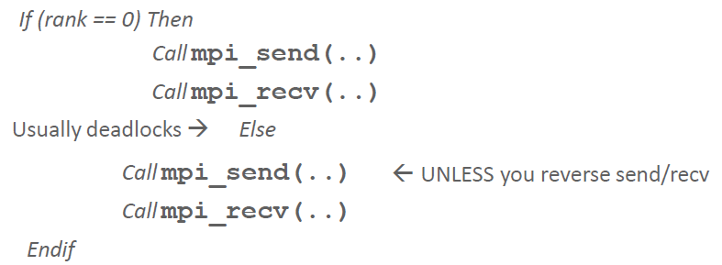
Summary (Blocking Send/Recv)
MPI_SEND does not return until buffer is empty (available for reuse)
MPI_RECV does not return until buffer is full (available for use)
MPI_Send is a blocking operation. It may not complete until a matching receive is posted.
Improper use may lead to Deadlocks too:

Slide 52
Non-Blocking Point-to-Point Communication

Slide 53
Non-Blocking Communication - Overview
User Mode
Kernel Mode
sendbuf
sysbuf
MPI_Isend(sendbuf,1,req)
(not blocked)
Copying data from
sendbuf to sysbuf
MPI_Wait(req)
(blocked)
Send data from
sysbuf to dest
Now sendbuf can be reused
Data
User Mode
Kernel Mode
MPI_Irecv(recvbuf,0,req)
Receive data from
src to sysbuf
(not blocked)
MPI_Wait(req)
Copying data from
sysbuf to recvbuf
(blocked)
Now recvbuf contains valid data
sysbuf
recvbuf

Slide 54
Non-Blocking Communication - Overview
Non-blocking Send
MPI_Isend(...)
doing some other work
MPI_Wait(...)
0
Non-blocking Receive
MPI_Irecv(...)
doing some other work
MPI_Wait(...)
1
= waiting until operation locally completed

Slide 55
Non-Blocking Send and Receive
MPI_ISEND(buf, count, datatype, dest, tag, comm, request)
MPI_IRECV(buf, count, datatype, dest, tag, comm, request)
request is a request handle which can be used to query:
Check the status of the communication
Or wait for the completion
Notes:
A non-blocking send call indicates that the system may start copying data out of the send buffer. The sender must not access any part of the send buffer after a non-blocking send operation is posted, until the complete-send returns.
A non-blocking receive indicates that the system may start writing data into the receive buffer. The receiver must not access any part of the receive buffer after a non-blocking receive operation is posted, until the complete-receive returns.

Slide 56
Non-blocking Communication
MPI_Isend or MPI_Irecv starts communication and returns request data structure
MPI_Wait (also MPI_Waitall, MPI_Waitany) uses request as an argument and blocks until communication is complete
MPI_Test uses request as an argument and checks for completion (non-blocking)
Advantages:
No deadlocks (using MPI_Test for completion check)
Overlap communication with computation
Exploit bi-directional communication
Notes:
Exploit bi-directional communication: Multiple send/recv operations could be in the process
MPI_Waitall: Waits for all given MPI Requests (array of request structures) to complete
MPI_Waitany: Waits for any specified number of MPI Request ( count and array of request structures) to complete

Slide 57
Non-Blocking Send and Receive (Cont.)
Demo: P2PNonBlock.c
MPI_WAIT (request, status)
MPI_TEST (request, flag, status)
MPI_WAIT will block until the non-blocking send/receive with the desired request is done
The MPI_TEST is simply queried to see if the communication has completed (TRUE or FALSE) is returned immediately in flag
Notes:
Status are error-code: MPI_SUCCESS or MPI_ERROR

Slide 58
Non-blocking Message Passing - Example
#include "mpi.h“
#include <stdio.h>
int main(int argc, char* argv[])
{
int rank, size;
int tag, destination, count;
int buffer;
tag = 1234;
destination = 1;
count = 1;
MPI_Status status;
MPI_Request request = MPI_REQUEST_NULL;
MPI_Init(&argc, &argv);
MPI_Comm_size(MPI_COMM_WORLD, &size);
MPI_Comm_rank(MPI_COMM_WORLD, &rank);
Demo: P2PNonBlock.c

Slide 59
Non-blocking Message Passing - Example
if (rank == 0) { /* master process */
buffer = 9999;
MPI_Isend(&buffer,count,MPI_INT,destination,tag,MPI_COMM_WORLD,&request);
}
if (rank == destination) /* slave process */
MPI_Irecv(&buffer, count, MPI_INT, 0, tag, MPI_COMM_WORLD, &request);
MPI_Wait(&request, &status); //Everyone wait here (both sender & receiver)
if (rank == 0)
printf("process %d sent %d\n", rank, buffer);
if (rank == destination)
printf("process %d rcv %d\n", rank, buffer)
MPI_Finalize();
return 0;
}

Slide 60
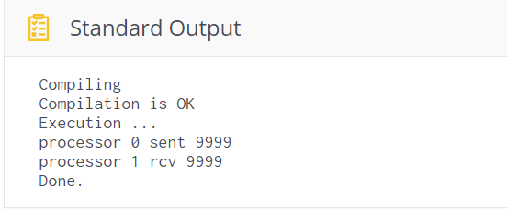
Non-blocking Message Passing - Example

Slide 61
MPI_Probe
Instead of posting a receive and simply providing a really large buffer to handle all possible sizes of messages
You can use MPI_Probe to query the message size before actually receiving it:
MPI_Probe(
int source,
int tag,
MPI_Comm comm,
MPI_Status* status)
Notes:
source: process rank

Slide 62
An Example
// Probe for an incoming message from process 0, tag 0
MPI_Probe(0, 0, MPI_COMM_WORLD, &status);
// When probe returns, the status object has the size and other
// attributes of the incoming message. Get the message size
MPI_Get_count(&status, MPI_INT, &number_amount);
// Allocate a buffer to hold the incoming numbers
int* number_buf = (int*)malloc(sizeof(int) * number_amount);
// Now receive the message with the allocated buffer
MPI_Recv(number_buf, number_amount, MPI_INT, 0, 0, MPI_COMM_WORLD, MPI_STATUS_IGNORE);
Demo: messageProbe.c

Slide 63
Any Questions

